Slide 1

Vidyavardhini’s College of Engineering and Technology
Department of Computer Engineering
2023-24

Slide 2
Course Project Presentation
Stock Price Prediction
Team Members;
07 Anish Patil
14 Ajay Shitkar
15 Gaurav Singh Guide: Dr. Megha Trivedi

Slide 3
Problem Statement:
Predict future stock prices based on historical data to assist investors and traders in making informed decisions.

Slide 4
Abstract:
Stock price prediction is a critical element in financial decision-making. This research focuses on developing a machine learning model that utilizes historical price data, trading volumes, and economic indicators to accurately forecast future stock prices. The findings demonstrate the significance of machine learning techniques in improving forecasting accuracy and guiding investment decisions.

Slide 5
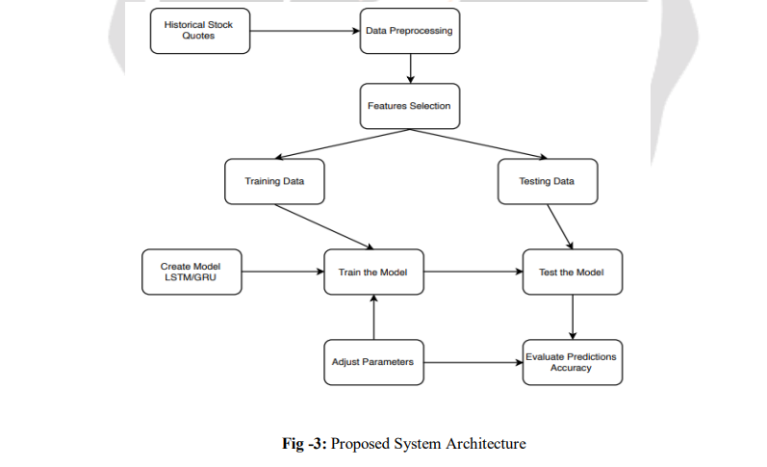
Proposed System Architecture

Slide 6
Proposed System
The purpose of this project is to create a neural network model for time series forecasting, specifically using an LSTM layer to capture sequential patterns in the data. The model aims to predict the next value in a time series based on the previous three values. The mean absolute error is also monitored as a performance metric.
LSTM Layer: This is the Long Short-Term Memory layer, which is designed to capture sequential dependencies in the data. The LSTM layer processes the input sequence, considering both the current input and the information from previous time steps.

Slide 7
Technologies Used
Python
Pandas
Google Collab
TensorFlow-Keras

Slide 8
Conclusion
Stock market prediction is implemented using the machine learning models LSTM which are modern versions of Recurrent neural networks. The LSTM model is trained by feeding past datasets and statistics upon which it has learned and adapted to the pattern and predicted the future stock price value, which is approximate and close to the original value.

